Slide 1
Passenger Lists and Emigration
Notes:
Slide 1
From Tracing Your Germanic Ancestors
p. 24
Most settled in the middle Atlantic colonies.
Immigrants before 1850 were mostly farmers.
After 1840, many German immigrants came to American cities, where “Germania’” or German-speaking districts, soon developed.
p. 25
Immigrants often travelled with friends.
Early Colonial German Passenger lists are available (Philadelphia)

Slide 2
Why Go to America?
Wars
Napoleonic (1803-1815)
Lure of Land
Unemployment high
Crop failures
Compulsive military service
1820, emigration is in full swing
Notes:
Slide 2
Review above from Tracing Your Germanic Ancestors
p. 26

Slide 3
The Lure
1830’s not boding well in Germany
Land scarce, mass-production and overproduction creating unemployment of Germans
Settlers from the Rhine region settle in IN, MO and OH
Notes:
Slide 3
Review above from Tracing Your Germanic Ancestors
p. 26

Slide 4
The Lure
1840’s emigration continues to rise
Mass production continues,
as does unemployment
Crop failures in the late 1840’s
Failure of the Revolution of 1848
causes many to flee
Notes:
Slide 4
Review above from Tracing Your Germanic Ancestors
p. 26

Slide 5
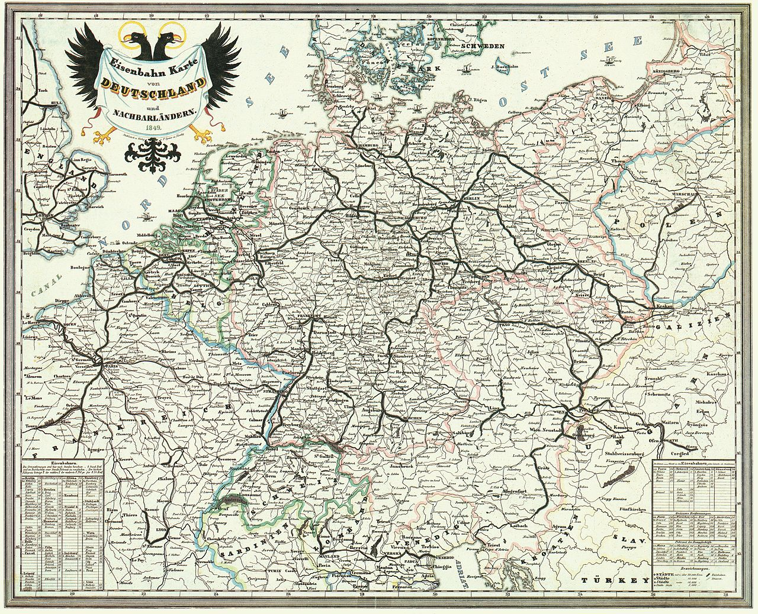
The Lure
1850’s Political upheaval
in Germany serves as a
catalyst for many to come
to America, the land of
democracy and opportunity
Unemployment continues
Railroads now in Germany makes travel easier to the ports
Notes:
Slide 5
Review above from Tracing Your Germanic Ancestors
pp. 26-27

Slide 6
The Ports of Departure
Bremen
Bremerhaven Museum
Ancestry-German Ship Crew Lists 1815-1917 (German)
Bremen Passenger Lists-Die Maus
Family Search-Archives and Libraries
Family Search-Birth, Marriage, Death Records
Bremen State Archive
Niedersachsen and Bremen Archives
CG Archives-Bremen Passenger Lists 1881-1951
Notes:
Slide 6
Review above from Tracing Your Germanic Ancestors
pp. 27-28

Slide 7
The Ports of Departure
Hamburg
The Hamburg State Archives
Germans to America
CG Archives-Hamburg Passenger Lists 1881-1951
Family Search-Hamburg Passenger Lists
German Roots-Hamburg Passenger Lists 1850-1934
Ancestry-Hamburg Passenger Lists 1850-1934
Notes:
Slide 7
Review above from Tracing Your Germanic Ancestors
pp. 28-30

Slide 8
Ancestry.com
Can review immigration records directly and easily
Immigration & Travel
Enter as much information that you have
Can search in sub-categories
Passenger Lists
Citizenship & Naturalization Records
Border Crossings & Passports
Crew Lists
Immigration & Emigration Books
Ships Pictures and Descriptions
Notes:
Slide 8
Review above.

Slide 9
Passenger Arrival Lists
Nationality, place of birth
Ship’s name, date of entry
Age, height, weight, eye color, hair color
Occupation/Profession
Place of last residence
Relatives – often traveled with friends
Notes:
Slide 9
Review above.

Slide 10
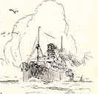
The Ships List
Can Search:
Passenger Lists
Fleet Lists
Ship Descriptions
Pictures
Rigging
Arrivals
Notes:
Slide 10
Review above.

Slide 11
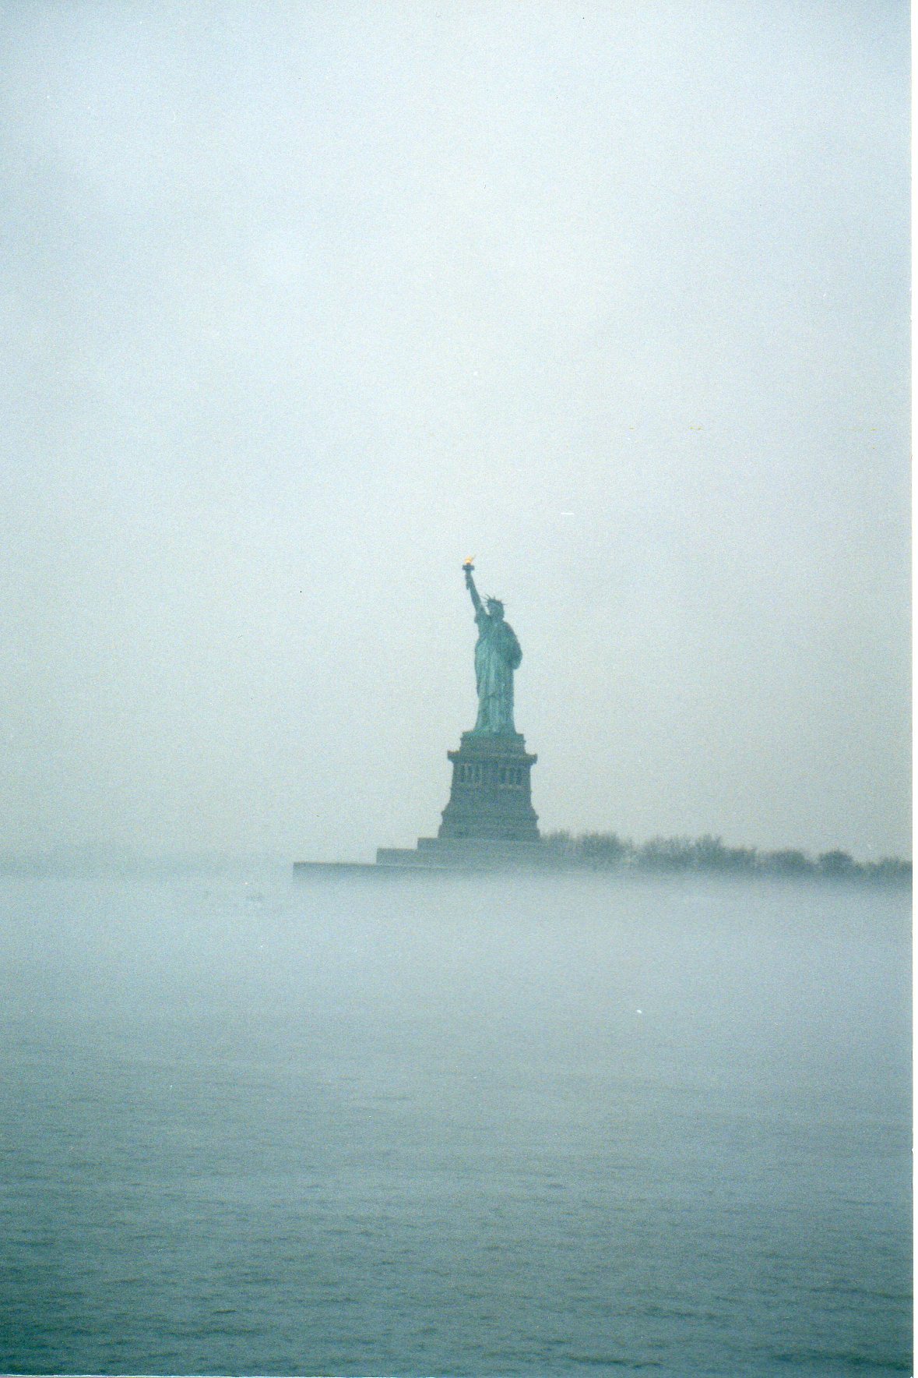
The Ports of Arrival
Castle Garden 1850-1890 11 million records
Simply walked down the gangplank onto
the wharf and their new home. No processing.
Two out of three immigrants came
through here
Ellis Island 1892-1954 12 million records
Baltimore
Philadelphia
New York
Notes:
Slide 11
Review above.
And Tracing Your Germanic Ancestors
pp. 30-31

Slide 12
Ship Pictures and History
Google It!
Lots of Information
http://www.norwayheritage.com/p_ship.asp?sh=wiela
http://www.jeffbraunger.com/Family%20History/Paternal/SS%20Wieland.html
Notes:
Slide 12
Review above.

Slide 13
Naturalization Records
From 1828-1906 anyone wishing to become an American citizen could do so by applying in any court in any place in the United States.
Only name, date, country of origin and allegiance were required.
Beginning 27 Sept 1906, records were filed with the court and the Bureau of Immigration and Naturalization.
Also check our National Archives.
Notes:
Slide 13
Review above.

Slide 14
Census Records
Confirms entry into the US
Check every decade to track relocation and family ties
Notes:
Slide 14
Review above.

Slide 15
Research
Happy Hunting!
Notes:
Slide 15.

